Slide 1
Do other people analyze data the way I do?
MCUAAAR V Analytic Core Seminar
November 27, 2017

Slide 2
Goals for today
Reproducibility in science
Complex questions, Complex data, Complex findings

Slide 3
Why did I ask you to read Silberzahn (2018)?
Describes a complex dataset
Data were “naturally occurring”/”organic” = “Not Intended for Research”
Data were multi-level (e.g., players nested within teams nested within years…) with lots of potential variables that could be included
Addresses a question that researchers may have strong beliefs about:
“Whether soccer players with dark skin tone are more likely than those with light skin tone to receive red cards from referees?”
Illustrates tools for promoting rigor and reproducibility in science
How the methods and results are presented
Use of the Open Science Framework (OSF) repository

Slide 4
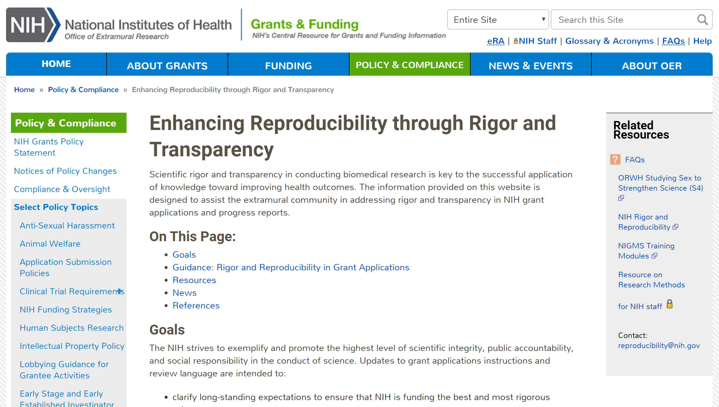

Slide 5
What does NIH mean by “scientific rigor”?
“The strict application of the scientific method to ensure robust and unbiased experimental design, methodology, analysis, interpretation and reporting of results. This includes full transparency in reporting experimental details so that others may reproduce and extend the findings. Investigators should apply the elements of rigor that are appropriate for their science.”
What does “robust” mean?
Robust results are obtained with solid, well-controlled experiments capable of being reproduced under well-controlled conditions using reported experimental details…. "Robust" and "unbiased" results are goals, not absolute standards to be met, and may vary across scientific disciplines.
Notes:
https://grants.nih.gov/reproducibility/faqs.htm#4829

Slide 6
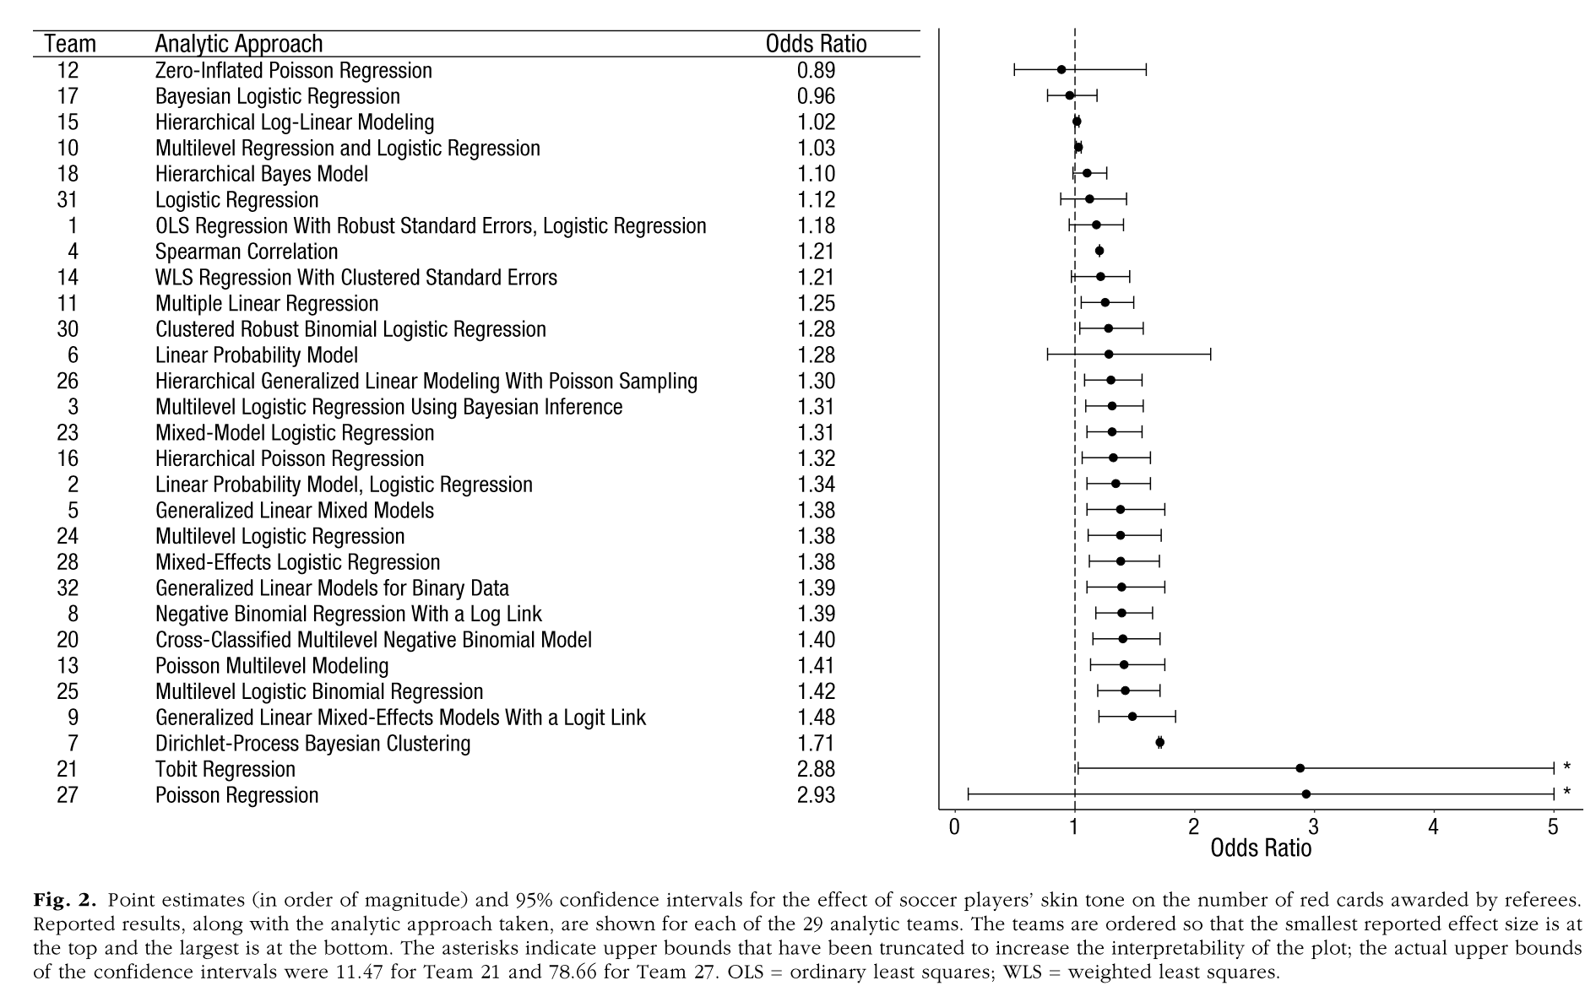
So, are players with dark skin tone more likely than those with light skin tone to receive red cards? Depends on who you ask.

Slide 7
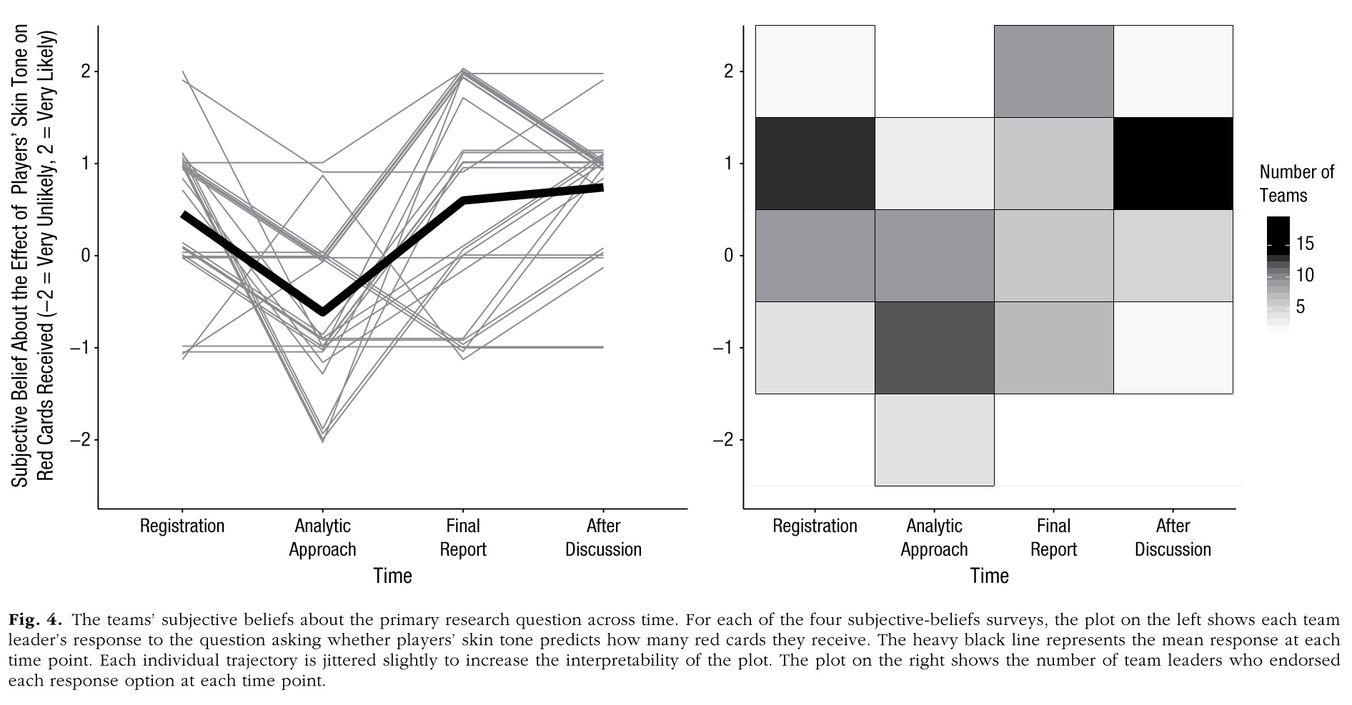
How did researchers’ beliefs about the answer to the research question change over time? Did they find what they already believed to be true, or did they update their beliefs based on the findings?

Slide 8
“In short, the analysts’ beliefs at registration regarding whether players with darker skin tone were more likely to receive red cards were not significantly related to the final effect sizes reported, but beliefs changed considerably throughout the research project, and as a result, the analysts’ post-analysis beliefs were significantly related to both the reported effect-size estimates and the lower bounds of the 95% CIs for these estimates. These results suggest that there was some updating of beliefs based on the empirical results. Although the sample size was small (N = 29), the overall results are more consistent with rational updating of beliefs based on the evidence than with confirmation bias.”

Slide 9
Did analyst expertise or peer-evaluated quality of approach explain the variability in the estimates?
Little to no evidence that this was the case*
*Recall, this conclusion (and the analysis of the influence of prior beliefs) was based on a sample size of 29.

Slide 10
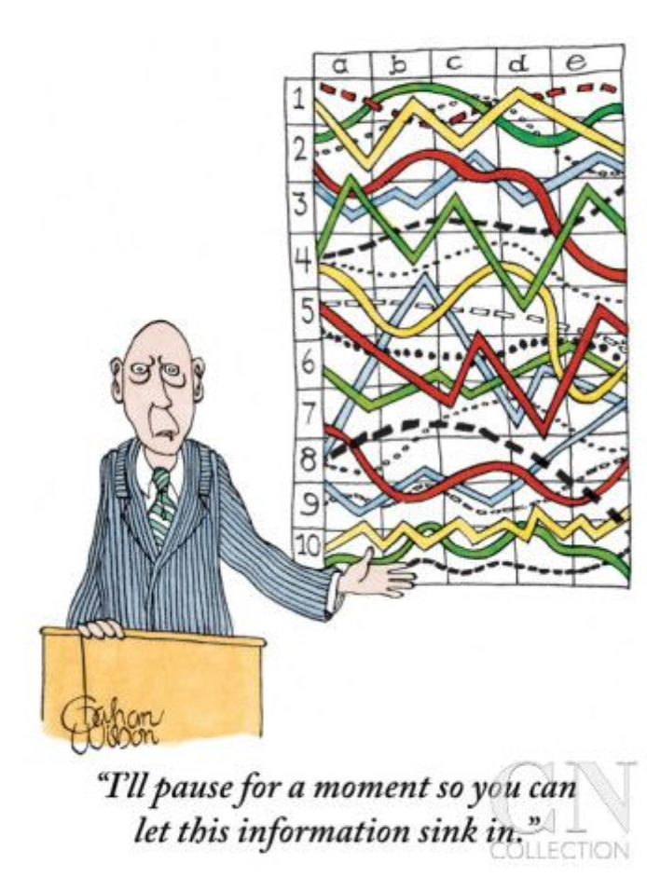
Group discussion
Are you surprised by their findings? Why or why not?
What are the limitations of their suggestion to “crowdsource” analytic approaches?
Have you had a situation in your own work when analyzing data when the fundamental interpretation (i.e., is (or isn't) X related to Y?) of your results depending on a choice of analytic approach? How did you deal with that?

Slide 11
The reproducibility problem illustrated by this study is distinct from other problems in scientific rigor
P-hacking: Consciously or unconsciously exploiting researcher degrees of freedom in order to achieve statistical significance.
Failing to report subsets of analyses that produce nonsignificant results and/or only reporting analysis that have statistically-significant results.
How could this occur “unconsciously”?
Specific decisions (e.g., adjust for age, assess non-linearity) made in the process of p-hacking may be independently justifiable, it can result in choosing an analytic strategy on the basis of whether or not it provides a desired result.

Slide 12
The reproducibility problem illustrated by this study is distinct from other problems in scientific rigor
Garden of forking paths aka Hypothesizing After Results are Known (HARKing): Testing for significance after patterns in the data have been observed
Turn “chance” findings into “meaningful” – albeit unexpected – results
Why is this a problem?
When you estimate a p-value for a specific relationship, the validity of the threshold of p<0.05 = significant depends on this being a hypothesis “test” not a hypothesis “confirmation”

Slide 13
What does this mean for scientific rigor?
There will almost always be variability in a measured effect depending on analytic choices.
Scientists can have comparatively more faith in a finding when there is less variability in analytic approaches taken to investigating the targeted phenomenon and in results obtained using different methods.
In extreme cases of little to no convergence in results, scientists should have no faith that the hypothesis is true, even if one or two teams find significant support with a defensible analysis—results that might have been publishable on their own.
In the case of this paper, there was general agreement supporting the hypothesis: All but 2 teams reported an OR>1 and 2/3 of teams reported a statistically-significant effect

Slide 14
What does this mean for your own work?
Talking to others about your study design and analytic approach is central to science, at all stages of research
Defining – and refining – the study question
How can you reduce selection bias in the comparison groups?
Collecting data
How can you reduce measurement bias in the assessment of exposure and outcome?
Using archival/existing data
What other information can you incorporate to address data limitations?
Choice and implementation of analytic approach

Slide 15
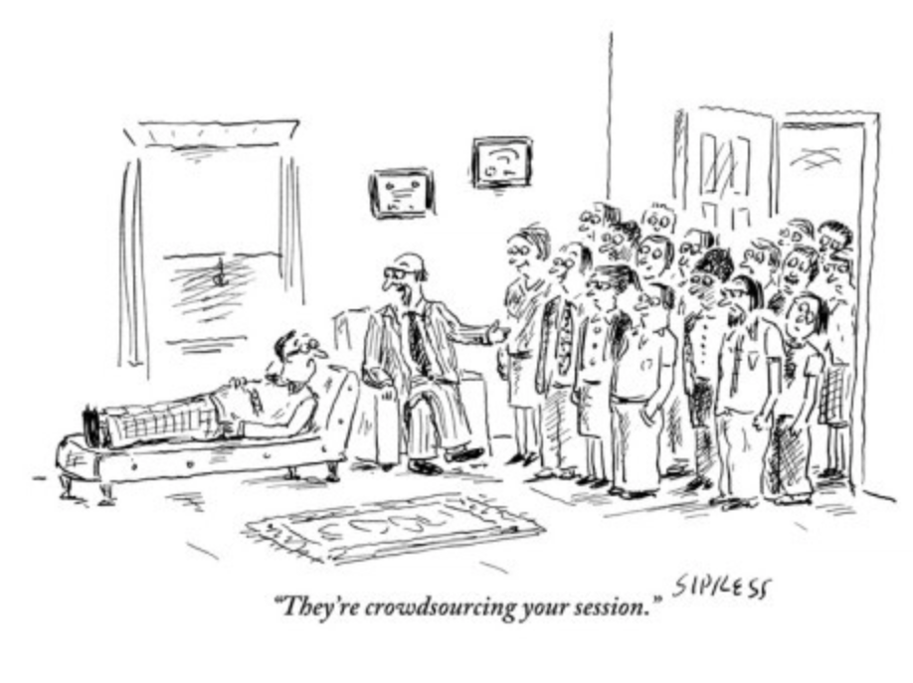
What does this mean for your own work?
Collaborating with researchers from different fields – who have different perspectives/training on study design and analysis – can help you identify alternative ways to formulate research questions and test hypotheses
Helps you become more reflective regarding your own assumptions of how to address a question

Slide 16
Group discussion
What does “reproducibility” mean in your field? How is it measured?

Slide 17
Other resources
NIH infographic summarizing rigor & reproducibility
https://grants.nih.gov/grants/RigorandReproducibilityChart508.pdf
Clearinghouse of NIH-funded online trainings on reproducibility
https://www.nigms.nih.gov/training/pages/clearinghouse-for-training-modules-to-enhance-data-reproducibility.aspx

