Slide 1
Get your suit, we’re going to the pool! Approaches for pooling across different datasets.
Briana Mezuk, PhD
MCUAAAR AnC Co-Director
February 19, 2020
bmezuk@umich.edu

Slide 2
The problem(s):
Your scientific question relates to a process that occurs over the life course, but you only have data on people of a particular age
The number of observations in your dataset is limited (sometimes recruitment doesn’t go as planned...)
You have multiple datasets that have information relevant to your question, and you have a feeling there’s a way you can make that work to your advantage, but you don’t know how

Slide 3
So what does it mean to “pool” datasets?
It means to take information you have on some people (i.e., CVD risk factors for younger people in one cohort) and apply it to a different set of people to “fill in” their values that you didn’t collect data on (i.e., CVD risk factors for people in another cohort who were older when data collection started for their cohort).
Q: What other situations do you know of when we take observed data and use it to “fill in” unobserved (missing) values?
A: Multiple imputation!

Slide 4
Inspiration for today’s session
Problem: We think that risk for cardiovascular disease (CVD) starts early in life, but few single cohorts have followed participants over the entire etiologically-relevant period.
So what? This means that we have limited information on effective prevention strategies.
Solution: POOL COHORTS that represent a range of participants over the life span.

Slide 5
Goal of this study
Aim: Use information from other cohorts, and what we know about the etiology of CVD, to impute early and midlife levels risk factors for CVD.
Lifecourse trajectories of CVD-related outcomes they wanted to impute: BMI, glucose, lipids, blood pressure.
Risk factors used to impute these outcome trajectories: smoking status, diabetes status, hypertension status, medication use for diabetes, hypertension, and high cholesterol.

Slide 6
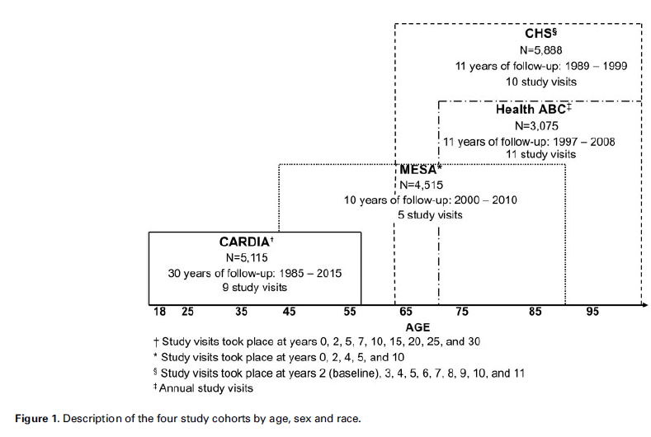
Four cohorts covering different periods of the life course
Coronary Artery Risk Development in Young Adults (CARDIA)
Multi Ethnic Study of Atherosclerosis (MESA)
Cardiovascular Health Study (CHS)
Health, Aging and Body Composition (Health ABC) Study

Slide 7
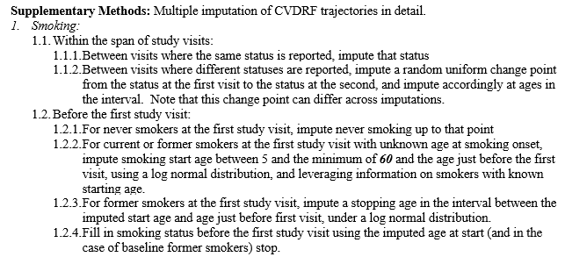
Necessary ingredients for pooling
Similar, if not identical, measures across the cohorts, which you operationalize in an identical way across all cohorts
Logic for imputation that you can implement consistently across all cohorts
Example here for how they imputed smoking status values across all cohorts.

Slide 8
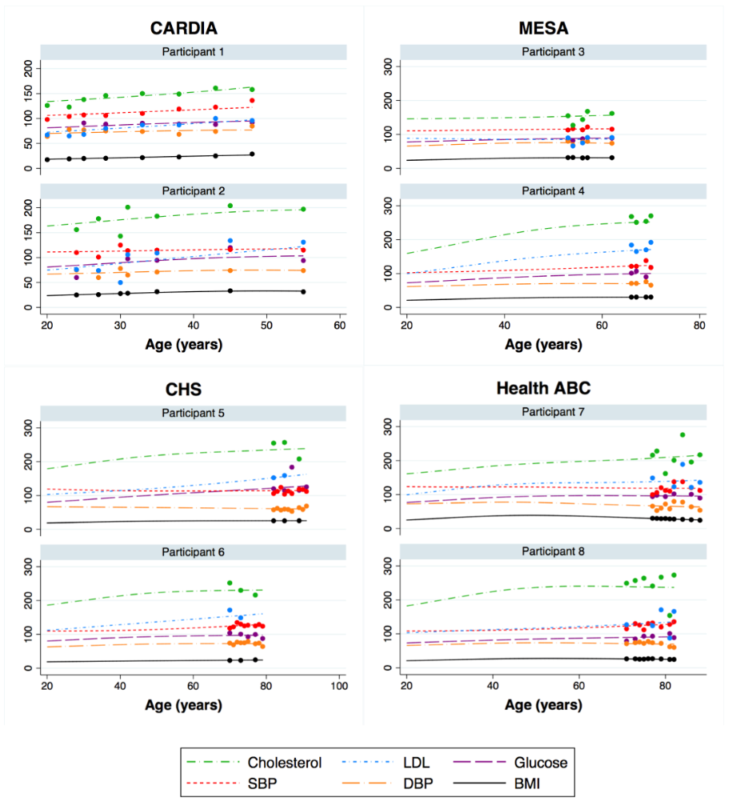
Observed data (dots) and imputed data (lines)
The main aim of this study was to impute CVD risk indicators for earlier in the adult life course, beginning from age 20 years, for participants with follow-up data beginning in mid-life or later in life.
For example, for a MESA participant first seen at age 45 and last seen at age 55, the expected CVD risks were imputed each year from age 20 to 55.
Implication: The amount of missing data imputed varied across the cohorts as a function of the age of participants at baseline.

Slide 9
How they pooled data from these cohorts to estimate life course trajectories of CVD risk
CVD outcome trajectories were estimated using linear mixed models (LMMs).
What is a mixed model? One that has both fixed and random effects.
And what are fixed and random effects…?
A fixed effect is a parameter that does not vary. That is, we assume there is some true regression line in the population (β) and we use our data to get some estimate of it (β-hat), which varies from sample to sample just because that’s the way sampling probability works.
A random effect is a parameter that is itself a random variable. That is, we assume that the true mean (population) β is not a single “true” value, but instead assume that β itself has a normal distribution with mean (μ) and a standard deviation (σ).
Nice resource on LMMs https://stats.idre.ucla.edu/other/mult-pkg/introduction-to-linear-mixed-models/
Random effects used in this study:
Intercept
Age

Slide 10
How they pooled data from these cohorts to estimate life course trajectories of CVD risk
These LMM were used to generate best linear unbiased predictions (BLUPs) for each person in the pooled data, annually from age 20-years until the end of follow-up for each participant.
Using those BLUP trajectories, they calculated period-specific time-weighted averages (TWAs) to summarize early (ages 20–39 years) and midlife (ages 40–59 years) CVD risk factors using data from all cohorts.
“Time-weighted” means that the values are set at zero at ages before the interval, time-dependent within the interval, and fixed at the value from the last age in the interval for ages post-interval.
Notes:
The interval-specific TWAs are zero at ages before the interval, time-dependent within the interval, and fixed at the value from the last age in the interval subsequently. As an example, the TWA for the 40-59 interval would be zero at ages <40, the average of the BLUPs for ages 40-45 at age 45, and the average of the BLUPs for ages 40-59 at every age from 59 forward.

Slide 11
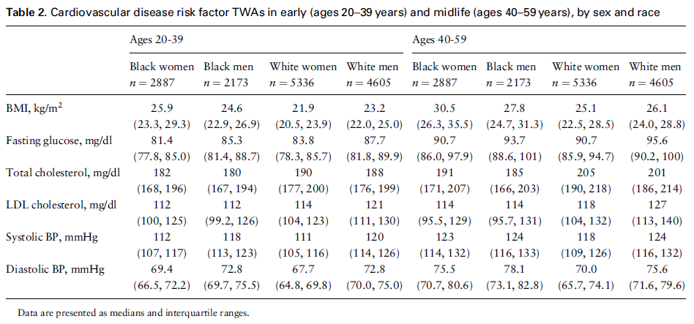
Overall time-weighted averages for the CVD risk indicators
Notes:
The interval-specific TWAs are zero at ages before the interval, time-dependent within the interval, and fixed at the value from the last age in the interval subsequently. As an example, the TWA for the 40-59 interval would be zero at ages <40, the average of the BLUPs for ages 40-45 at age 45, and the average of the BLUPs for ages 40-59 at every age from 59 forward.

Slide 12
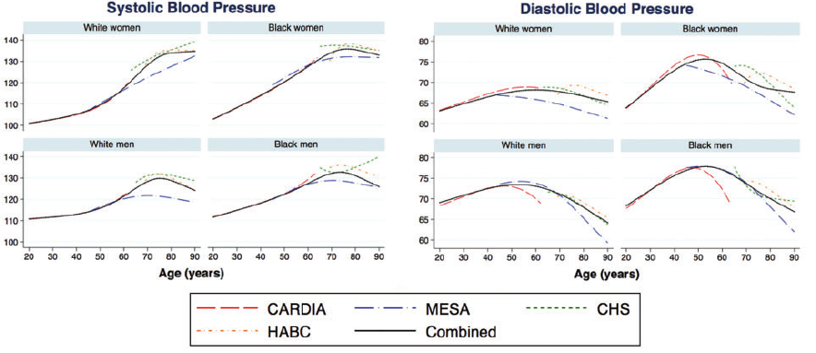
Life course trajectories of cardiovascular disease risk factors across categories of sex and race, results from the specific cohorts and pooled cohort.
Notes:
The interval-specific TWAs are zero at ages before the interval, time-dependent within the interval, and fixed at the value from the last age in the interval subsequently. As an example, the TWA for the 40-59 interval would be zero at ages <40, the average of the BLUPs for ages 40-45 at age 45, and the average of the BLUPs for ages 40-59 at every age from 59 forward.

Slide 13
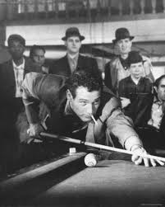
Other types of pools: Prediction modeling using an external dataset
Step 1: Find another dataset that has data on similar measures as the ones that you are hoping to “fill in” information on.
Step 2: Estimate a logistic regression model in the external dataset to generate beta-coefficients for a “prediction model” that you will use to estimate the missing values in your data.
Step 3: Append the external dataset to your dataset.
Step 4: Fit the prediction model on the entire sample (actual + external) and use the predicted probabilities from the logistic regression model to “fill in” the missing data in your primary data.
Notes:
https://www.ncbi.nlm.nih.gov/pubmed/31353189

Slide 14
Other types of pools:
Prediction modeling using an external dataset
What type of problem does this solve?
You have systematic missing data on a variable of interest and don’t feel that other missing data approaches (e.g., multiple imputation) are appropriate.
Ex. Some of your respondents were simply not asked a question because of a skip pattern in the interview.
When is it an appropriate solution?
When you have an external dataset that is sufficiently similar to the one you are working with in terms of population, scope, and - most importantly - measures, but doesn’t have the same missing data problem as your dataset.
Notes:
https://www.ncbi.nlm.nih.gov/pubmed/31353189

Slide 15
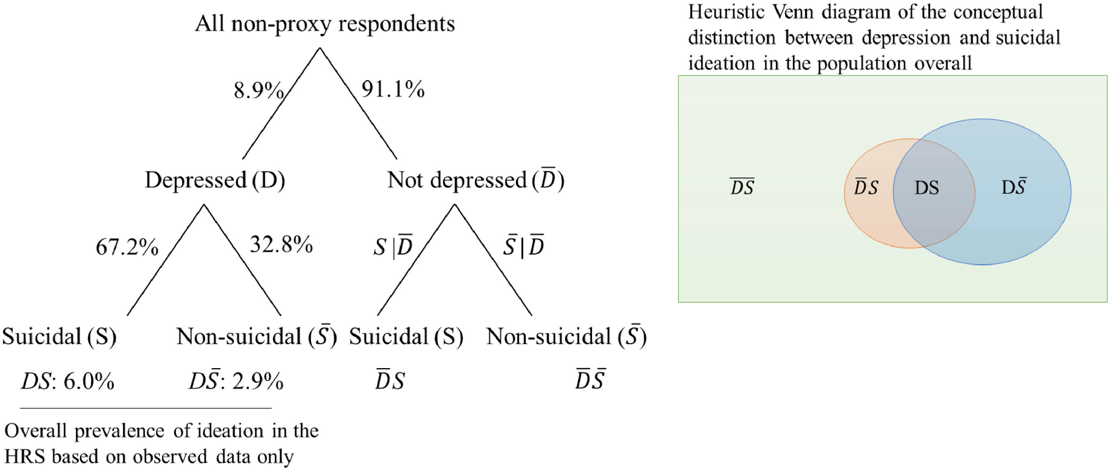
Example:
Prediction modeling using an external dataset
The Question: What is the prevalence of passive suicidal ideation among older adults in the US?
The Problem: The HRS only asks participants the item on suicidal ideation if they first endorse feelings of depression (skip pattern).
Solution:
1. Find an external dataset that doesn’t have this skip pattern: Baltimore ECA
2. Use it to empirically estimate the predictors of suicidal ideation among people who are not depressed
3. Append the ECA to the HRS and apply those beta-coefficients back to the HRS to estimate the size of the -D/+S group.
Notes:
https://www.ncbi.nlm.nih.gov/pubmed/31353189

Slide 16
Other types of pools
Meta-analysis: is a quantitative, formal, epidemiological study design used to systematically assess the results of previous research to derive conclusions about that body of research.
Notes:
https://www.cochranelibrary.com/cdsr/doi/10.1002/14651858.CD009132.pub2/full?highlightAbstract=withdrawn%7C*dementia

Slide 17
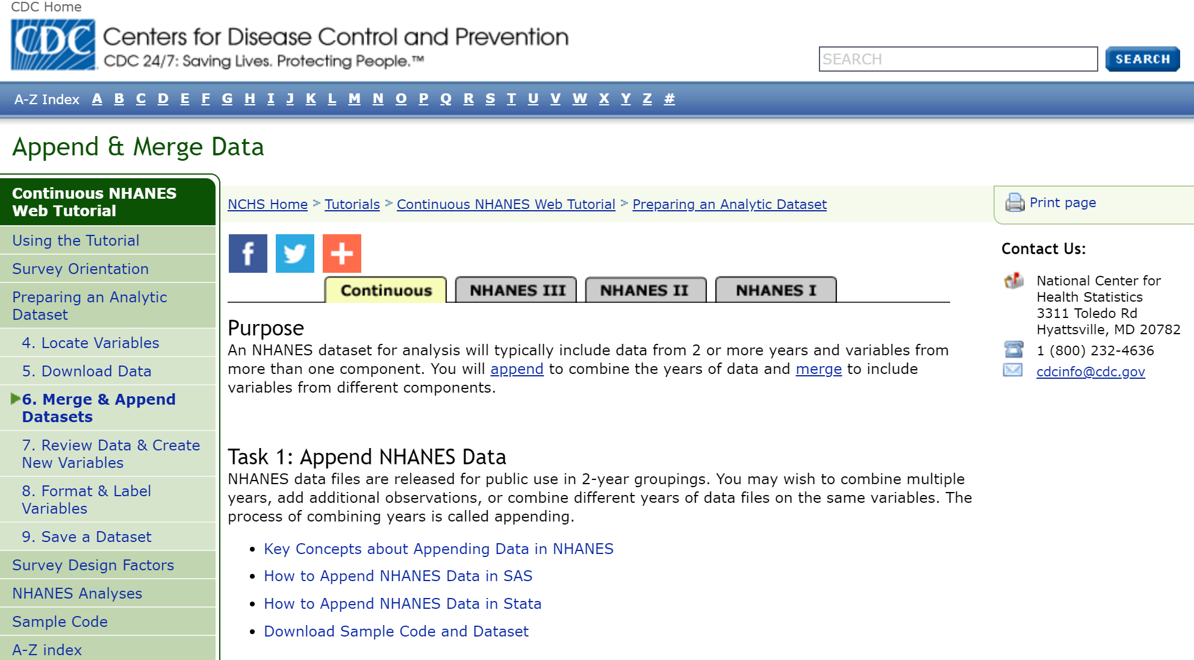
Appending cross-sectional panels as a way to pool
Some data are designed for pooling! NHANES has specific instructions for how to do this.
Why? To increase statistical power, particularly if your question concerns smaller demographic subgroups
Notes:
https://www.cdc.gov/nchs/tutorials/NHANES/preparing/AppendMerge/intro.htm

Slide 18
Types of problems pooling does not solve
Differential attrition (healthier people are more likely to stay in your study over time)
Survival bias (healthier people more likely to make it to older age, where your study begins)
May inadvertently “smooth out” meaningful variation

Slide 19
Summary
The fundamental idea underlying pooling datasets is that you can take information in one study and use it to “fill in the gaps” in another, related study.
There are several variations on this theme, but they all stem from the idea that the data you have can be used to impute the data you do not.
Like all imputation strategies, these approaches can address some sources of bias but at a cost of precision.

Slide 20
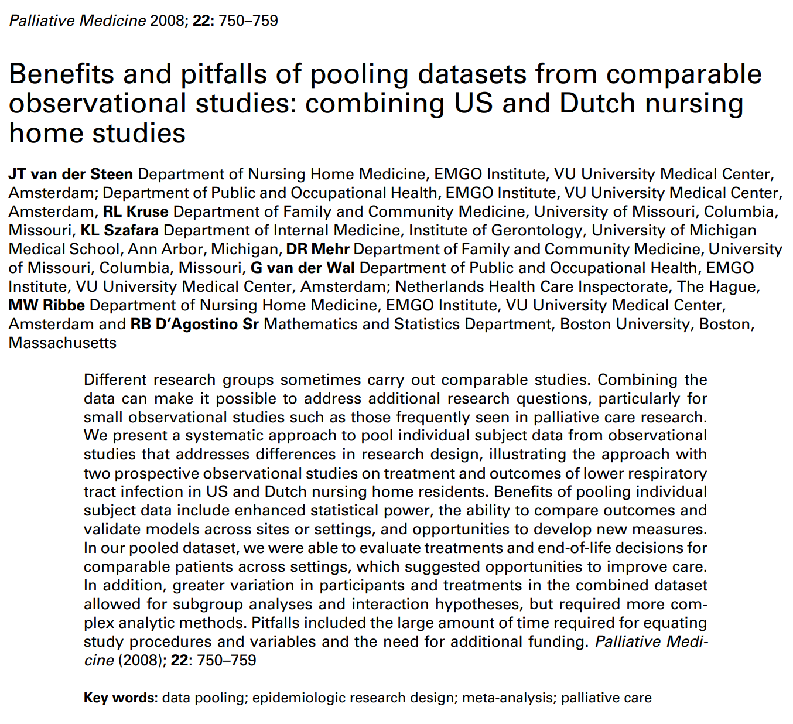
Further reading...

