Slide 1
The Arts and Crafts of Grant Writing
Briana Mezuk, PhD
Center for Social Epidemiology and Population Health
University of Michigan
bmezuk@umich.edu

Slide 2
A caveat before we begin
My grant writing has been limited to NIH and major foundations
I have reviewed grants for international organizations and NIH (study section)
This lecture draws heavily from my experience as a scholar with the NIMH Advanced Research Institute in Geriatric Mental Health (a workshop focused on writing NIH proposals)
Howard Hizenstein, Yeates Conwell, Warren Taylor, Joe Gallo

Slide 3
Dahlberg B, Wittink M, Gallo JJ. Funding and publishing integrated studies: Writing effective mixed methods manuscripts and grant proposals. In: Tashakkori A, Teddlie C, eds. Handbook of Mixed Methods in Social & Behavioral Research. 2nd ed. London: Sage Publications; 2010:775-802.
…and is preferable when explaining why YOU are the right person do this project (e.g., “our prior work showed that…”; “building on our prior findings, we aim to…”; “our long-standing collaboration…”)
© 2009, Johns Hopkins University. All rights reserved.

Slide 4
Writing specific aims
Most important component of your proposal
Reviewers “judge” the entire proposal based on this 1 page, then look in the proposal to confirm specifics
Determines the “ceiling” of your grant score – it generally only goes DOWN the more the reviewers read, not up

Slide 5
Writing specific aims
Use the aims page as a “prospectus” to get feedback on from colleagues
Iterate, iterate, iterate
Spend most of your time on this 1 page – your score only goes down from here

Slide 6
Specific aims requirements
NIH: 1 page that ‘states concisely the goals of the proposed research and summarizes the expected outcomes, including the impact that the results will exert on the field’
List the specific objectives of the research proposed (e.g., test a specific hypothesis, create a novel design, address a critical barrier to progress in the field)

Slide 7
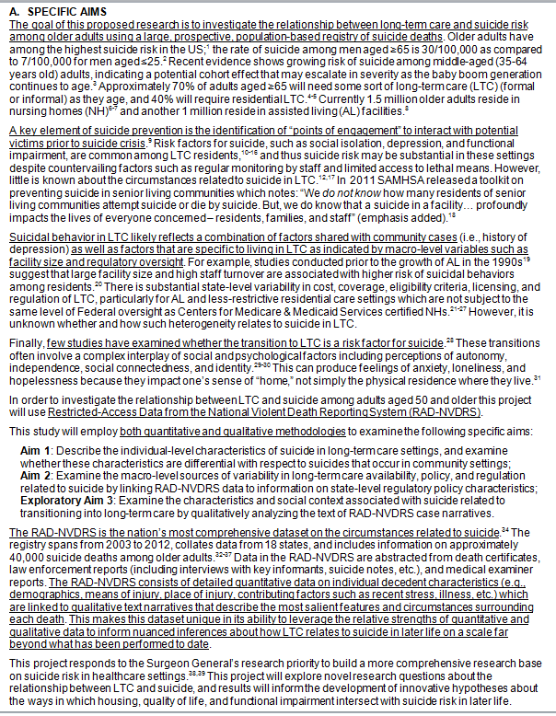
Format of specific aims page
1st paragraph: importance, main strategy, overarching goal
The goal of this proposed research is to investigate the relationship between long-term care and suicide risk among older adults using a large, prospective, population-based registry of suicide deaths.

Slide 8
Format of specific aims page
2nd & 3rd paragraphs: Overview of approach and describe strengths of approach

Slide 9
Format of specific aims page
Aims/objectives and brief description
Visually set apart
Aim 1: Describe the individual-level characteristics of suicide in long-term care settings, and examine whether these characteristics are differential with respect to suicides that occur in community settings;

Slide 10
Format of specific aims page
Last paragraph: IMPACT
This project responds to the Surgeon General’s research priority to build a more comprehensive research base on suicide risk in healthcare settings.^{38,39} This project will explore novel research questions about the relationship between LTC and suicide, and results will inform the development of innovative hypotheses about the ways in which housing, quality of life, and functional impairment intersect with suicide risk in later life.

Slide 11
How many aims?
Projects are rarely “too narrow” – issue is creating a project that is not “overly ambitious”

Slide 12
How many aims?
2 to 4 aims: more is harder to support within page limits vs. less
2 – 4 hypotheses for each aim (inversely related to number of aims)
1st aim is most conservative (e.g., extending directly on preliminary data)
2nd & later aims become more integrative & speculative
Can have exploratory aims (if you don’t have sufficient data, enough power, etc)

Slide 13
Tips on writing aims
Work – and rework – these many, many times
“Every word hurts”
Need to be succinct and CLEAR, including to people who do NOT have expertise in this specific area
Reviewer should be able to anticipate the analysis plan based on the aims
Aims should be related to each other, but not interdependent
If Aim 1 is not upheld, are Aims 2 – 4 still reasonable?

Slide 14
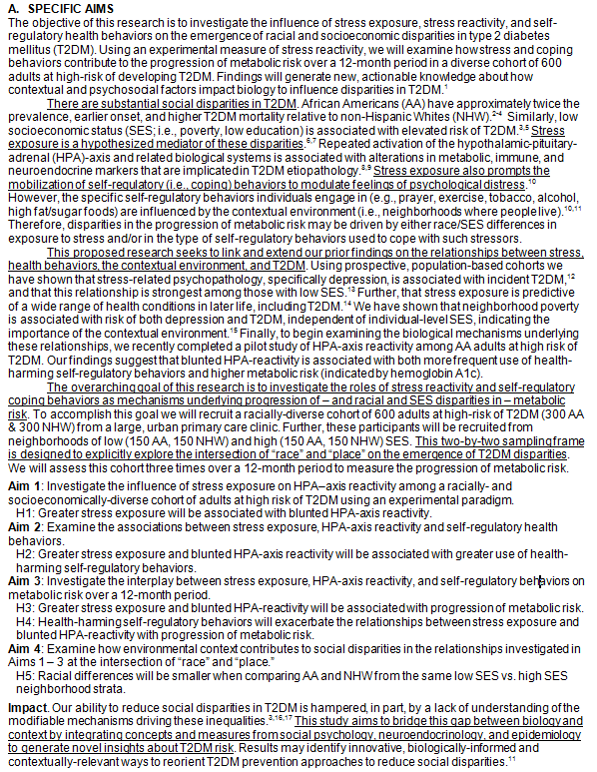
Consider how the review criteria apply/can be addressed in the aims page
Impact
Findings will generate new, actionable knowledge about how contextual and psychosocial factors impact biology to influence disparities in T2DM.
Our ability to reduce social disparities in T2DM is hampered, in part, by a lack of understanding of the modifiable mechanisms driving these inequalities

Slide 15
Consider how the review criteria apply/can be addressed in the aims page
Impact
Significance
There are substantial social disparities in T2DM. African Americans (AA) have approximately twice the prevalence, earlier onset, and higher T2DM mortality relative to non-Hispanic Whites (NHW).²⁻⁴ Similarly, low socioeconomic status (SES; i.e., poverty, low education) is associated with elevated risk of T2DM.^{3,5} Stress exposure is a hypothesized mediator of these disparities.^{6,7}

Slide 16
Consider how the review criteria apply/can be addressed in the aims page
Impact
Significance
Investigator
This proposed research seeks to link and extend our prior findings on the relationships between stress, health behaviors, the contextual environment, and T2DM. Using prospective, population-based cohorts we have shown that …

Slide 17
Consider how the review criteria apply/can be addressed in the aims page
Impact
Significance
Investigator
Innovation
“…bridge this gap between biology and context by integrating concepts and measures from social psychology, neuroendocrinology, and epidemiology to generate novel insights about T2DM risk. Results may identify innovative, biologically-informed and contextually-relevant ways to reorient T2DM prevention approaches to reduce social disparities.

Slide 18
Consider how the review criteria apply/can be addressed in the aims page
Impact
Significance
Investigator
Innovation
Approach
Using an experimental measure of stress reactivity, we will examine how stress and coping behaviors contribute to the progression of metabolic risk over a 12-month period in a diverse cohort of 600 adults at high-risk of developing T2DM.

Slide 19
Consider how the review criteria apply/can be addressed in the aims page
Impact
Significance
Investigator
Innovation
Approach
Environment
“…goal we will recruit a racially-diverse cohort … from a large, urban primary care clinic.”

Slide 20
Overall strategy
Top critiques of grant reviewers
Too ambitious
Not feasible

Slide 21
How to address these critiques
AT: Too ambitious
AT: Not feasible
Be honest with yourself: Is it? If so, in what way?
Proposed sample is too large
Proposed data collection is too intense
Proposed project aims are too complex and inter-connected
Not enough contingency plans for when things go awry
Team is too inexperienced
Strengthen your team: Find people who have the expertise you need and demonstrate you can work with them (i.e., publish something together; collect pilot data together)
Get your papers: Letters of support, especially from anyone outside the academy you plan to work with, is essential.
Explain yourself better by making room for what matters: ¾ of your proposal should be your Approach – cut down your Significance and Innovation sections
Provide pilot data for your concept: your prior publications; new analyses from existing data (e.g., ICPSR)
Provide pilot data for your approach: recruitment of even just a few people (<10) is sufficient
Make sure you have appropriate power analyses for each aim/main question
Simulate if you don’t have a good sense of effect size from your pilot data (or even if you do!)

Slide 22
How to convey IMPACT
Conditional on a solid approach: Significance x Innovation = IMPACT
Significance
Findings will improve Public health, Clinical care, Service delivery, Treatment technology, Create new scientific knowledge…
Attentive to funder’s Strategic Plan/Priorities
Significance is NOT a “public health crisis”

Slide 23
Writing for tired, weary, and blurry-eyed reviewers
Every paragraph should have one – and only one – major point
This point should be made in the FIRST sentence of the paragraph
WHITE SPACE IS YOUR FRIEND
Pages should be easy to look at – charts/diagrams/tables are good

Slide 24
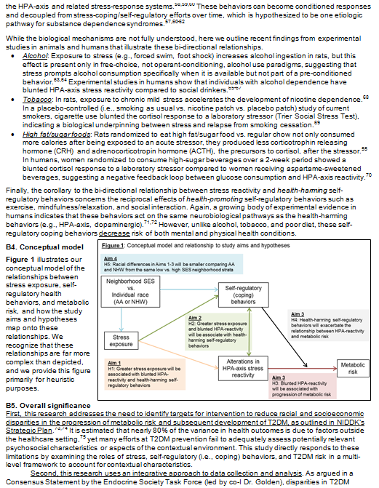
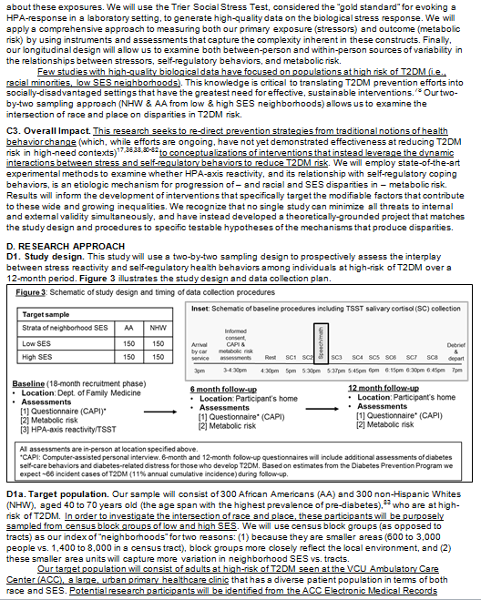

Slide 25
Writing for tired, weary, and blurry-eyed reviewers
Use headers: Text should be easy to navigate
Be CONSISTENT in your language, terms, concepts – minimize abbreviations
Repetition is useful – keeps the reader oriented, can be used to link aims to methods

Slide 26
Writing for tired, weary, and blurry-eyed reviewers
Charts, diagrams & tables
Useful for conveying a conceptual model
Study design
Recruitment protocol
Preliminary data
Break up the text – make it easier to read
Must be completely congruent with the text
If you aren’t going to investigate a relationship in your study, then it shouldn’t show up in your conceptual model

Slide 27
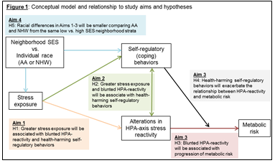
Conceptual model has a 1:1 relationship with Aims

Slide 28
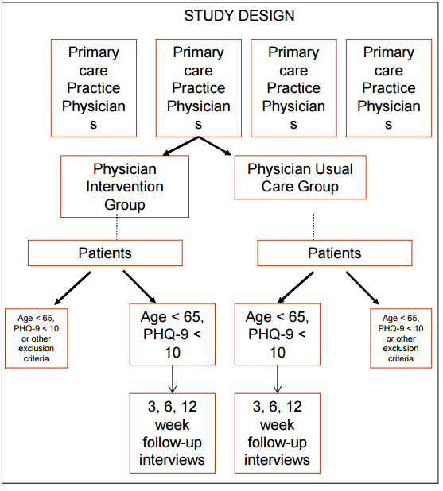
Diagram of study design
We will use a 4-site physician-randomized design. Patients age 65+ who screen PHQ-9>9 and are not taking antidepressants will be recruited and interviewed at baseline, 3 weeks, 6 weeks and 12 weeks. Other inclusion criteria include MMSE>24, ability to give informed consent, life expectancy >6 months, and speak English or Spanish.

Slide 29
Explain yourself
Justify every key design element [e.g., inclusion/exclusion criteria, recruitment strategy, follow-up duration, choice of instruments, outcomes]
For controversial/potentially divisive elements of your design discuss:
Why you selected the element you did (strengths vs alternatives)
Other options you considered

Slide 30
Getting feedback on your proposal
On the approach
Program officer, scientists, colleagues
On the overall logic
Colleagues, non-scientists
On style/clarity
Yourself (read out-loud), a good friend
ALWAYS read the document AFTER spellchecking

Slide 31
Reviewers
Important to know the audience that will be reviewing (study sections)
Talk with program officer
Be clear in your proposal how your grant aligns with program/funder priorities
…this research addresses the need to yadda yadda yadda, as outlined in NIDDK’s Strategic Plan...

Slide 32
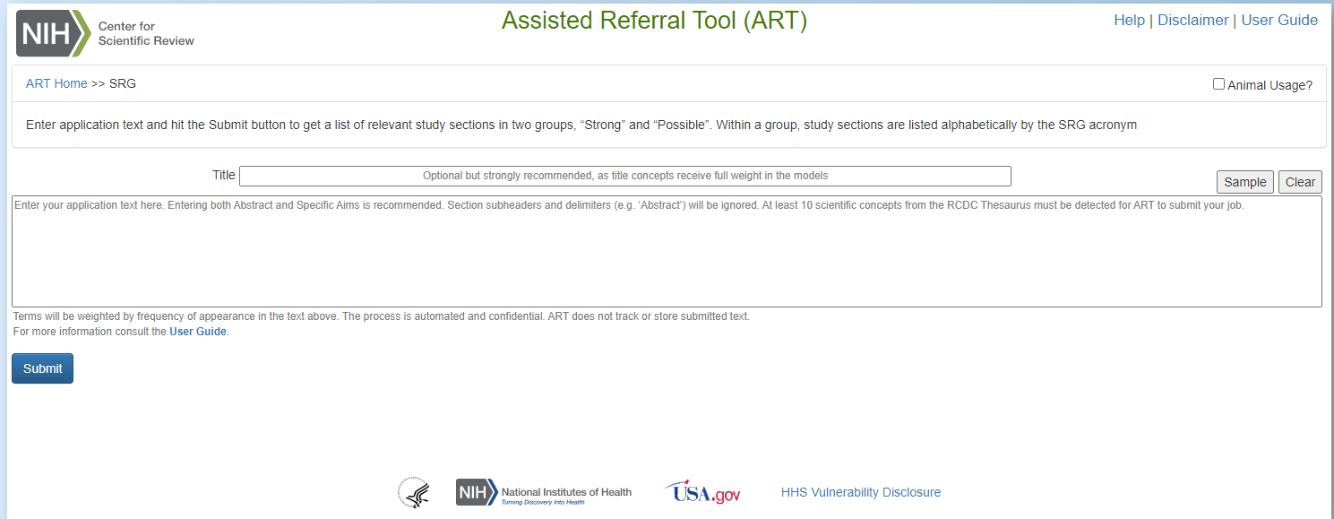
Find your study section

Slide 33
Timelines
GOAL | Proposal due date
Subtract…
Time needed by your grant’s office to process the proposal | -2 weeks
Time to revise, edit & polish | - 1 week
Time to send draft for external review | -4 weeks
Time to revise based on internal review | -4 weeks
Time needed to get internal review | -2 weeks
Time to plan (ID collaborators), write first draft, and create budget | -12 weeks
Contact program officer about grant idea | -4 weeks
Discuss grant idea over coffee (or something stronger) with colleagues | -2 weeks
Total time needed to write grant | 31 weeks (~ 8 months)

Slide 34
Discussion & general strategies
If possible, get a copy of someone else’s successful grant submission (of the type you are applying) to assess for format, style, etc.
Helps to translate the “grant-ese” that you read in RFAs/RFPs
Develop good working relationships with your grant pre-award staff – they are critical to your sanity as you write the grant

Slide 35
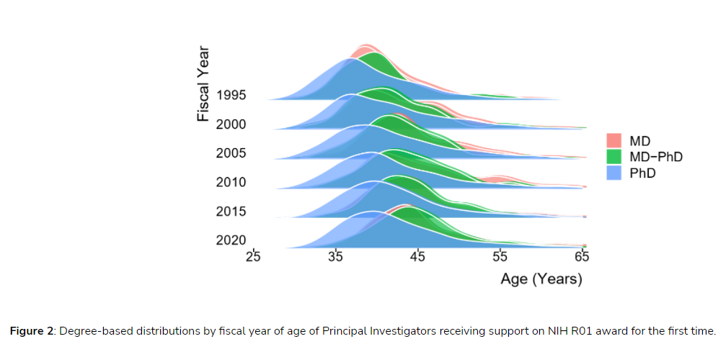
Plan for the long game
Mean and Median age at first R01 award for PhDs in 2020?
43 and 41, respectively.

Slide 36
RCMAR resources
Notes:
https://rcmar.org/webinar/surviving-and-responding-to-the-nih-grant-review-webinar-nov-13/

Slide 37
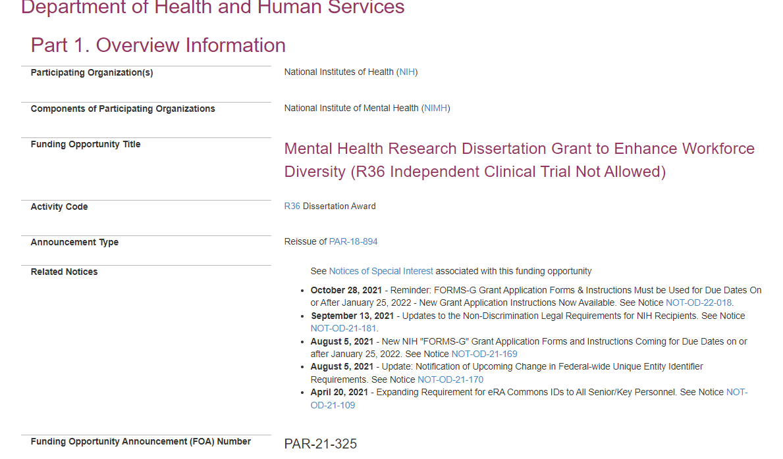
For your students

Slide 38
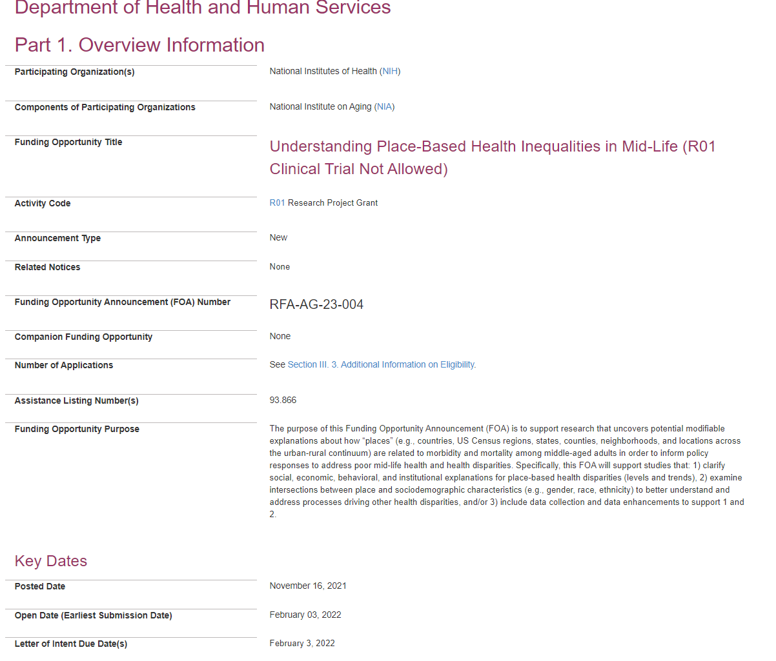
For you

Slide 39
Other resources
Grant sources
http://grants.nih.gov/grants/grant_tips.htm
http://www.grants.gov/web/grants/search-grants.html
Webinars
https://m.youtube.com/watch?v=hFBRgiyTt7E
https://m.youtube.com/watch?v=3p-AeXhiS4w
https://m.youtube.com/watch?feature=youtu.be&v=M84wRv5V-EI
http://public.csr.nih.gov/aboutcsr/contactcsr/pages/contactorvisitcsrpages/nih-grant-review-process-youtube-videos.aspx

