Slide 1
Discussion: How do we assess a racial disparity in health? Distribution, interaction, and interpretation in epidemiological studies
Ward et al (2019)
Source: Ward, J. B., Gartner, D. R., Keyes, K. M., Fliss, M. D., McClure, E. S., & Robinson, W. R. (2019). How do we assess a racial disparity in health? Distribution, interaction, and interpretation in epidemiological studies. Annals of epidemiology, 29, 1-7. https://doi.org/10.1016/j.annepidem.2018.09.007

Slide 2
Context
Interest: Targets that can help eliminate health disparities
Mechanism: Interactions
Problem: Focus on the interaction
Solution: A more comprehensive look at differences

Slide 3
Three guiding rules
Assess the difference in outcome prevalence in both groups
Assess the difference in exposure prevalence in both groups
Investigate if and how the association between outcome and exposure differ by groups
The basic idea:
(3) alone can miss the point
(3) needs to be refereed in the context of (1) and (2)

Slide 4
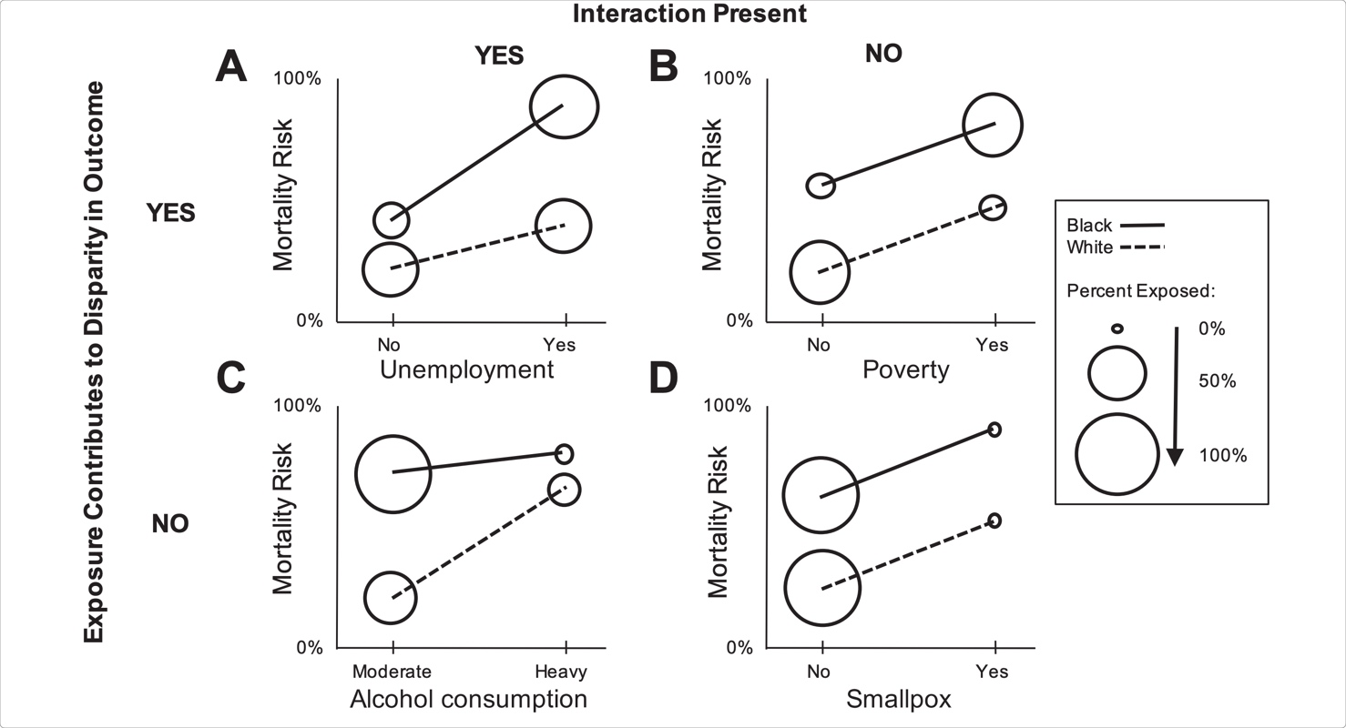
Alternative Scenarios
Source: Ward, J. B., Gartner, D. R., Keyes, K. M., Fliss, M. D., McClure, E. S., & Robinson, W. R. (2019). How do we assess a racial disparity in health? Distribution, interaction, and interpretation in epidemiological studies. Annals of epidemiology, 29, 1-7. https://doi.org/10.1016/j.annepidem.2018.09.007

Slide 5
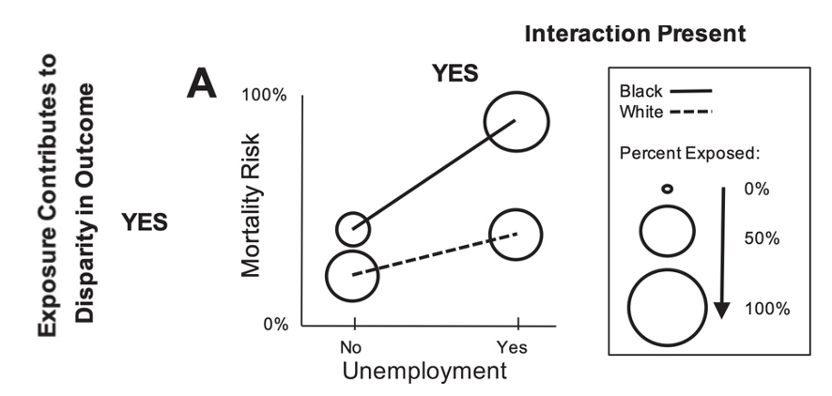
Scenario A
Source: Ward, J. B., Gartner, D. R., Keyes, K. M., Fliss, M. D., McClure, E. S., & Robinson, W. R. (2019). How do we assess a racial disparity in health? Distribution, interaction, and interpretation in epidemiological studies. Annals of epidemiology, 29, 1-7. https://doi.org/10.1016/j.annepidem.2018.09.007

Slide 6
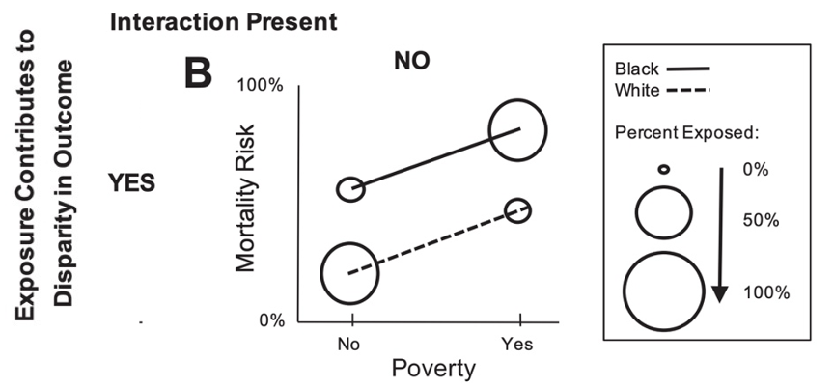
Scenario B
Source: Ward, J. B., Gartner, D. R., Keyes, K. M., Fliss, M. D., McClure, E. S., & Robinson, W. R. (2019). How do we assess a racial disparity in health? Distribution, interaction, and interpretation in epidemiological studies. Annals of epidemiology, 29, 1-7. https://doi.org/10.1016/j.annepidem.2018.09.007

Slide 7
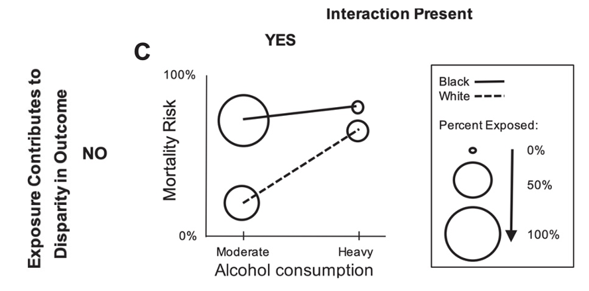
Scenario C
Source: Ward, J. B., Gartner, D. R., Keyes, K. M., Fliss, M. D., McClure, E. S., & Robinson, W. R. (2019). How do we assess a racial disparity in health? Distribution, interaction, and interpretation in epidemiological studies. Annals of epidemiology, 29, 1-7. https://doi.org/10.1016/j.annepidem.2018.09.007

Slide 8
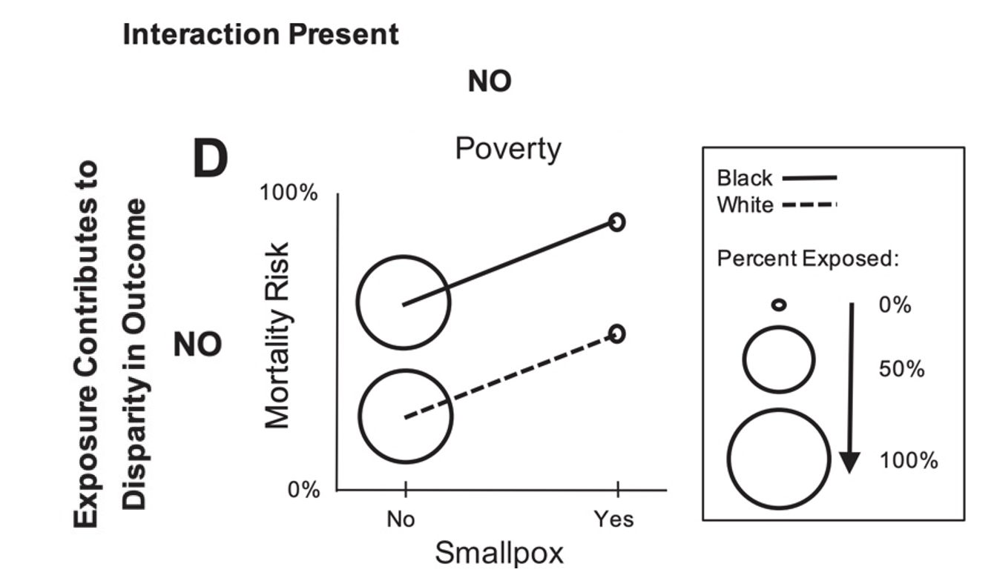
Scenario D
Source: Ward, J. B., Gartner, D. R., Keyes, K. M., Fliss, M. D., McClure, E. S., & Robinson, W. R. (2019). How do we assess a racial disparity in health? Distribution, interaction, and interpretation in epidemiological studies. Annals of epidemiology, 29, 1-7. https://doi.org/10.1016/j.annepidem.2018.09.007

Slide 9
Alternative Scenarios
Source: Ward, J. B., Gartner, D. R., Keyes, K. M., Fliss, M. D., McClure, E. S., & Robinson, W. R. (2019). How do we assess a racial disparity in health? Distribution, interaction, and interpretation in epidemiological studies. Annals of epidemiology, 29, 1-7. https://doi.org/10.1016/j.annepidem.2018.09.007

Slide 10
Conclusion
Examine all three elements to reach a decision about “meaningful”/targetable between group differences:
Outcome rates
Exposure rates
Interaction
If exposure -> outcome
Between group distribution of exposure plays a critical role in determining disparity in the outcome.
Difference in exposed rates should inform decision about “intervention targeting the exposure” to reduce disparity (independent of interaction).

